Slide 2
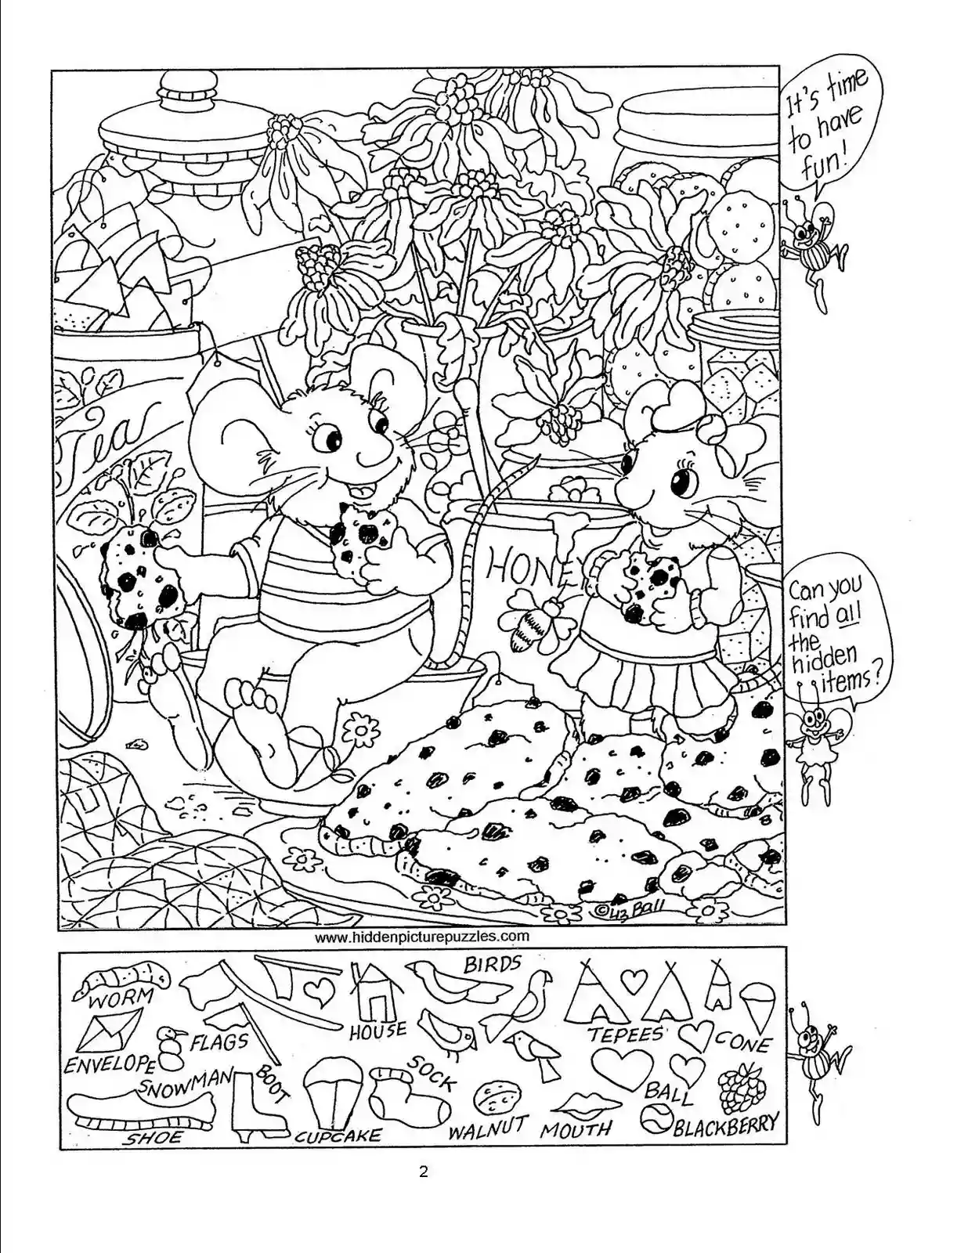

Slide 3
I wonder what your most important treasure is……

Slide 4
The Lost Coin
Written by Marion Barella
Illustrated by Jayne Pugsley

Slide 5
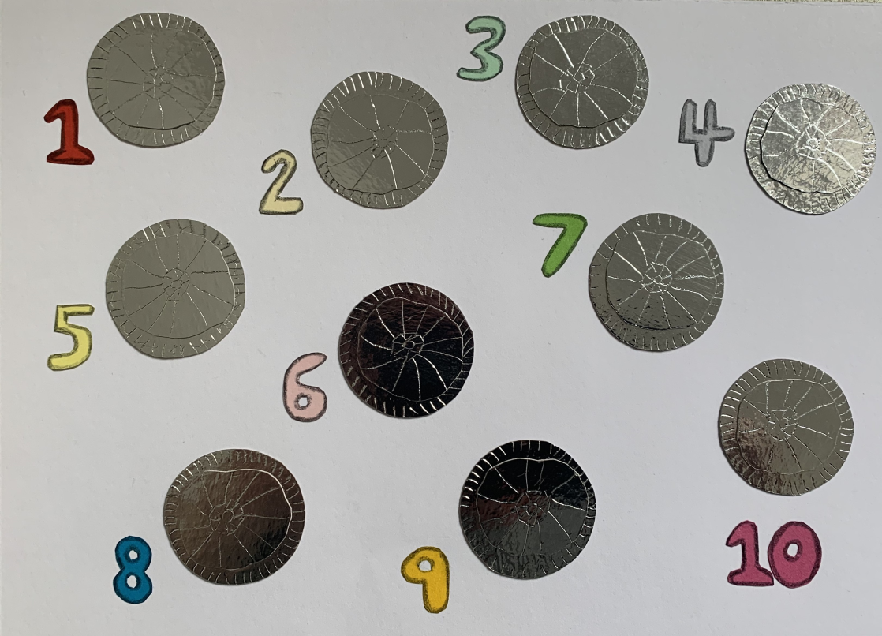
1,2,3,4,5,6,7,8,9,10 shiny coins sparkled in the sun.
1,2,3,4,5,6,7,8,9,10 shiny coins jangled in her hand.
1,2,3,4,5,6,7,8,9,10 shiny coins were a special treasure.
These ten coins were the only coins that she owned.

Slide 6
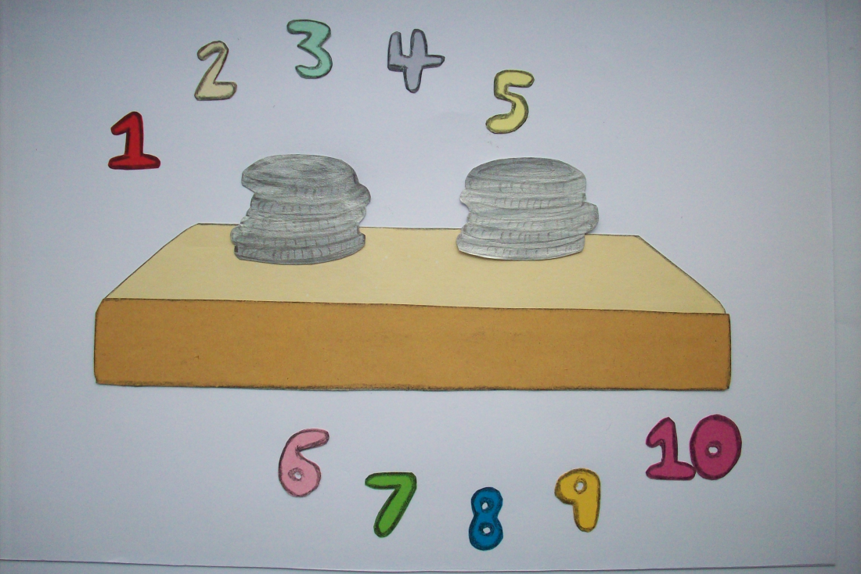
There once was a lady who had 10 coins
She kept them safe in her home upon a little shelf
And every now and then she liked to count her coins
She counted from number one, and up to number ten.

Slide 7
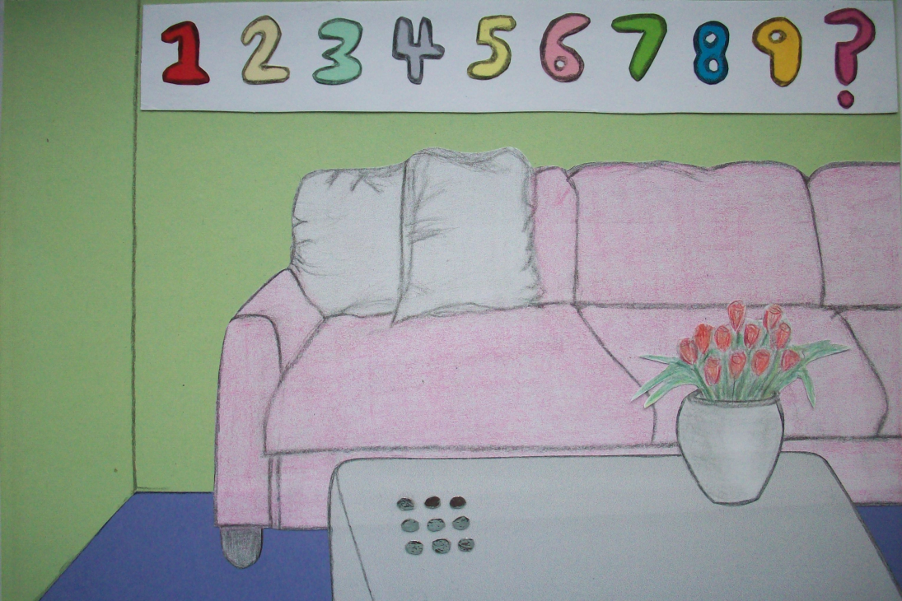
One day the lady thought I’ll count my coins today
To make sure they are safe and then I’ll put them away.
She started to count from one.
But something was wrong
1, 2,3,4,5,6,7,8,9 shiny coins. Where is number 10?

Slide 8
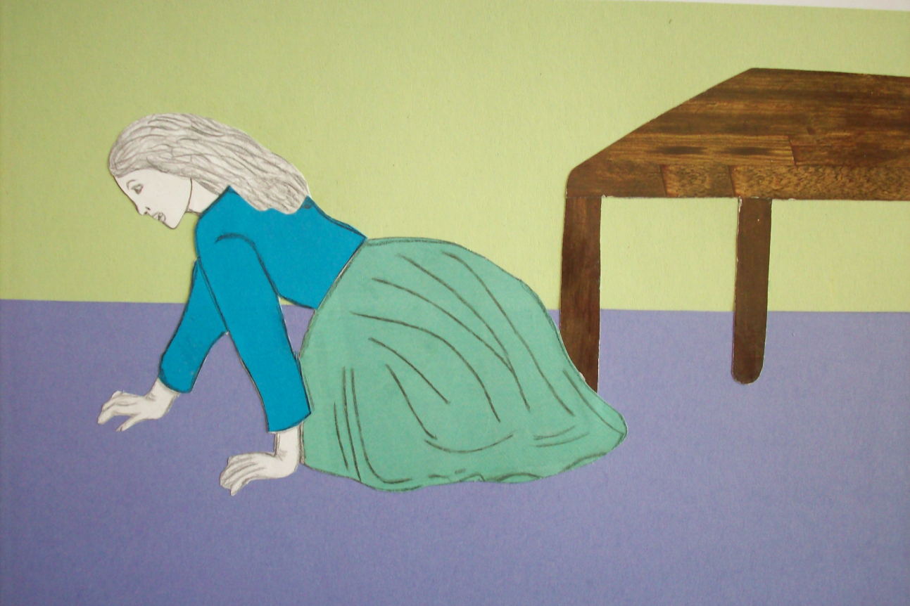
The lady checked the bag, and then she checked the table.
Then she got onto her knees and looked in every corner
She looked in every bag and in the pockets of her clothes
But the lost coin could not be found was it lost forever?

Slide 9
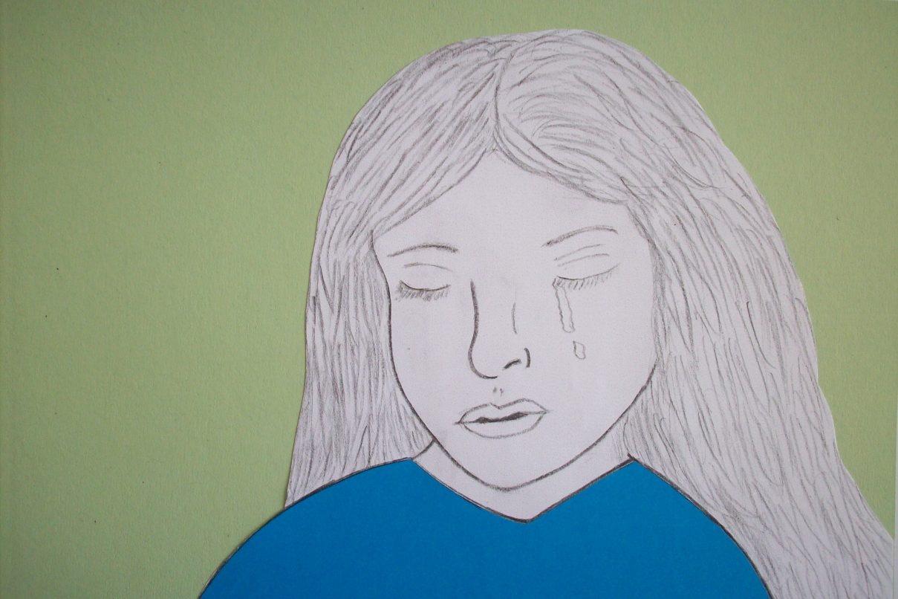
She decided to count the coins again just to check her maths.
But it was the same as before she counted from one to nine
The poor lady was just so sad, she began to cry.
Oh what am I going to do about my poor lost coin?

Slide 10
I wonder what the lady is going to do?

Slide 11
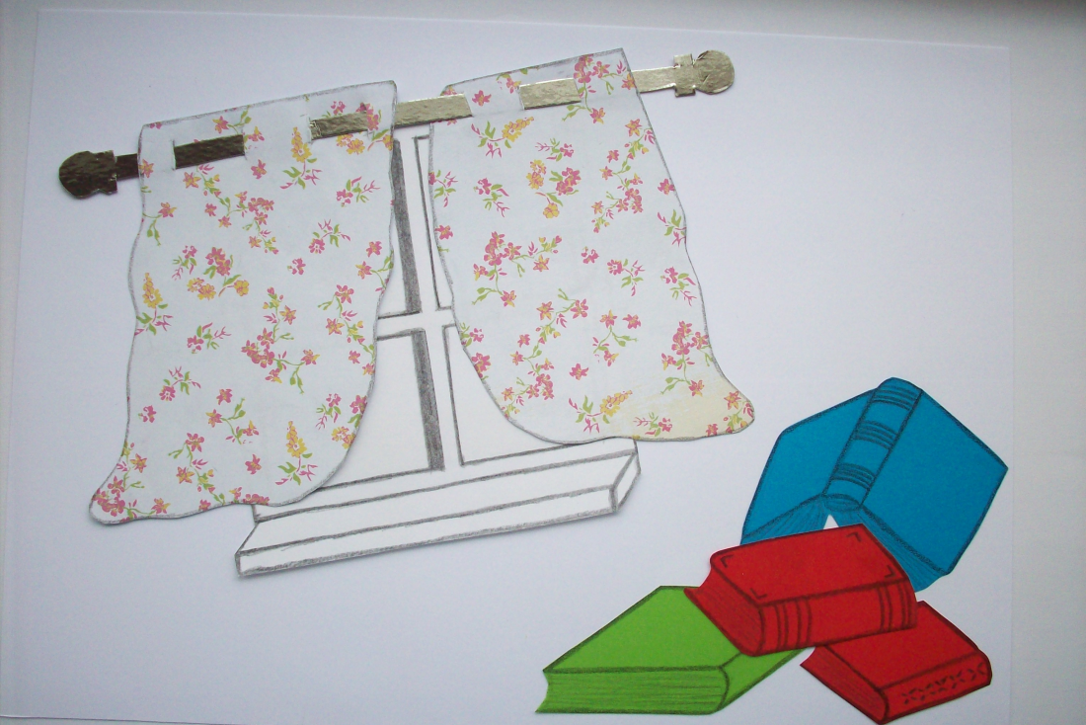
The lady looked in the pages of every single book
She looked behind the curtains and brushed away some dust
But there was no coin in the books or hiding in the curtains.
The woman sat and said “this coin is here I’m certain”!!!

Slide 12
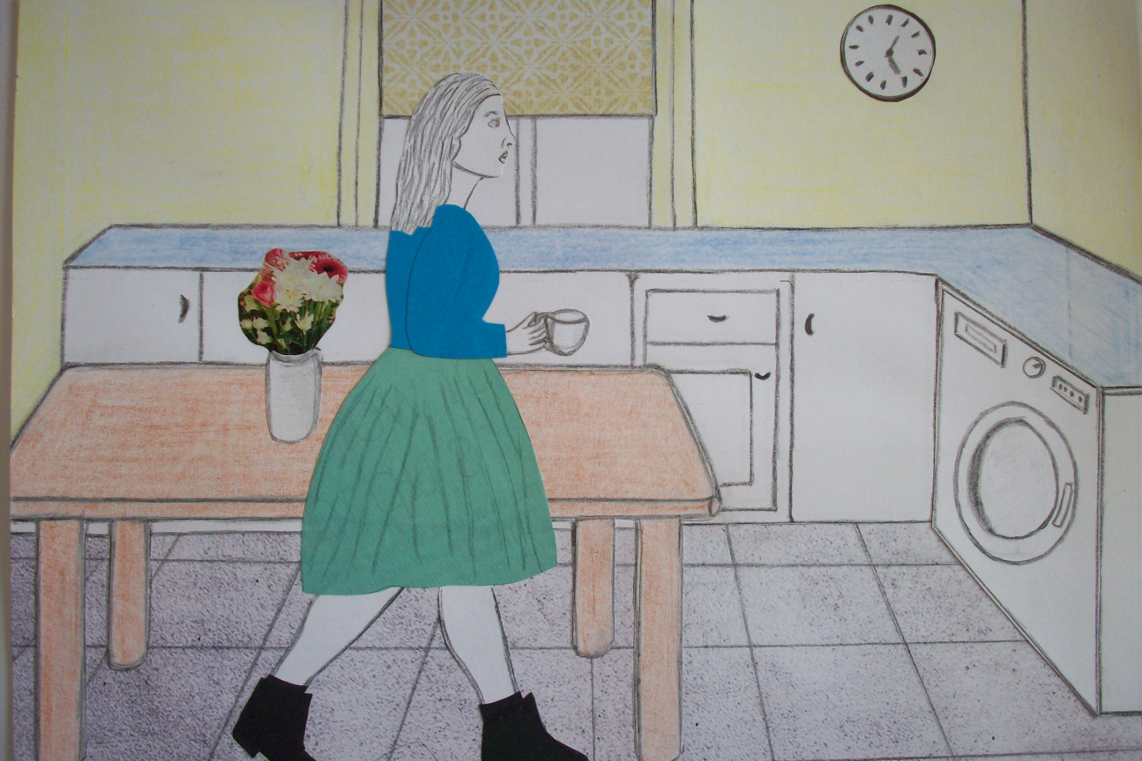
She looked all around the little room; she really didn’t have a clue
She thought I need a cup of tea and then I’ll go and look again
As she lifted up her cup she thought she heard a little jangle!!
I wonder what’s in here I just wanted a cup of tea!!

Slide 13
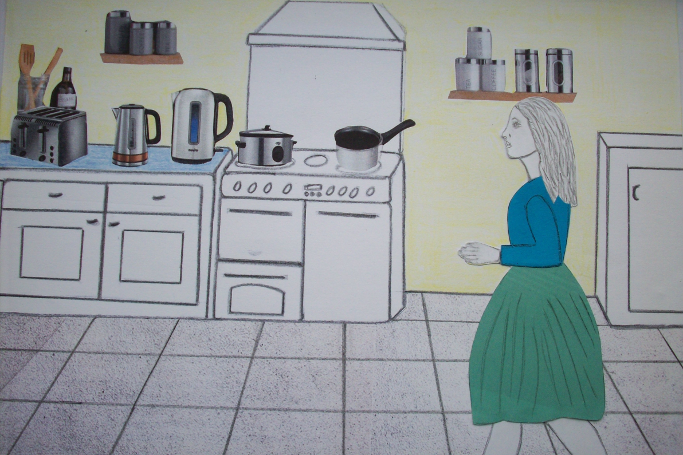
Then the woman scratched her head, did my coin grow legs!!
I’ll go and look somewhere else in another room
The lady left her living room and walked into the kitchen
There were lots of shiny things in here like her saucepans and her kettle.

Slide 14
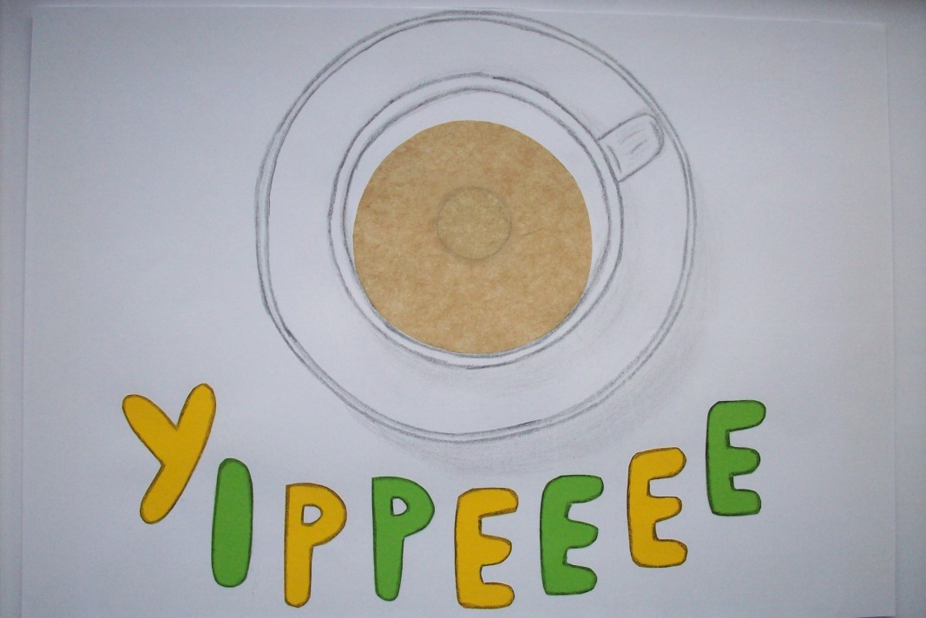
The woman looked in her cup…and heard another jangle
The saw something shimmering and glimmering and shiny
Oh wow could it be my lost coin?
YIPPEEEEE she cheered my coin it’s found.

Slide 15
1,2,3,4,5,6,7,8,9,10 shiny coins sparkled in the sun.
1,2,3,4,5,6,7,8,9,10 shiny coins jangled in her hand.
1,2,3,4,5,6,7,8,9,10 shiny coins were a special treasure.
These ten coins were the only coins that she owned.

Slide 16
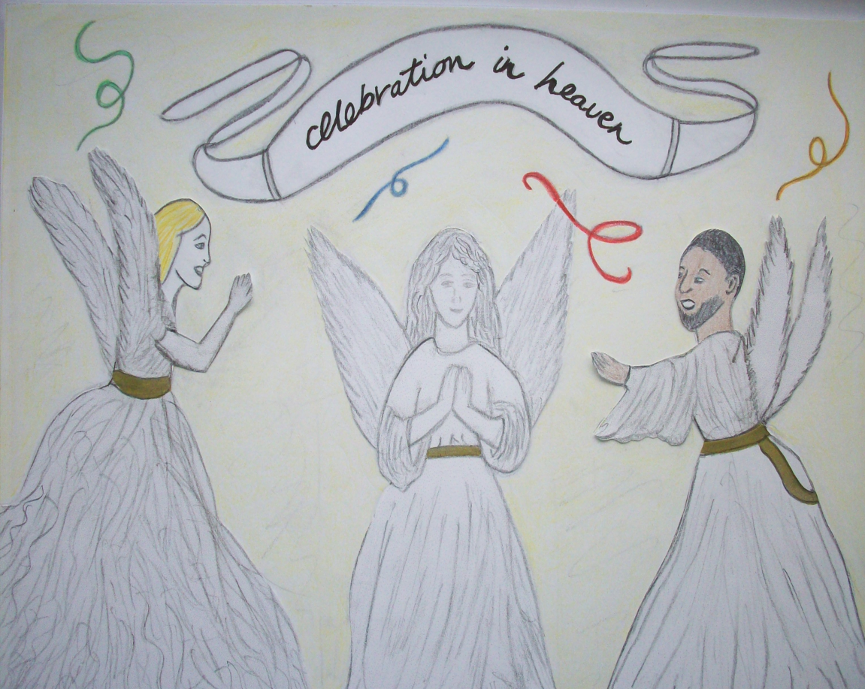
Jesus told this parable to show us how much God loves.
We are the lost coin, and the woman is God.
God will take time to find us when we are lost.
And he will celebrate when are with Him again.

Slide 17
Look up the website www.dltk.com for lots of activities to this story.

Slide 18
I Spy…..I wonder if you can find the object in your classroom or at home beginning with the letter…..

